Slide 1
Ensemble
Part 2: Navigating Ensemble

Slide 2
Navigating Ensemble
Overview
Components on Production Configuration page
Event Log Viewer
Message Viewer
Visual Trace
Notes:
Components on Production Configuration page
Settings (Class Name, Adapter Class Name, Component/Adapter-specific settings)
Event Log, Messages, Queue, Jobs
Event Log Viewer
Text, Source, Job, Time
Production-level event logs (No Source)
Message Viewer
Header fields
Search Criteria
Visual Trace

Slide 3
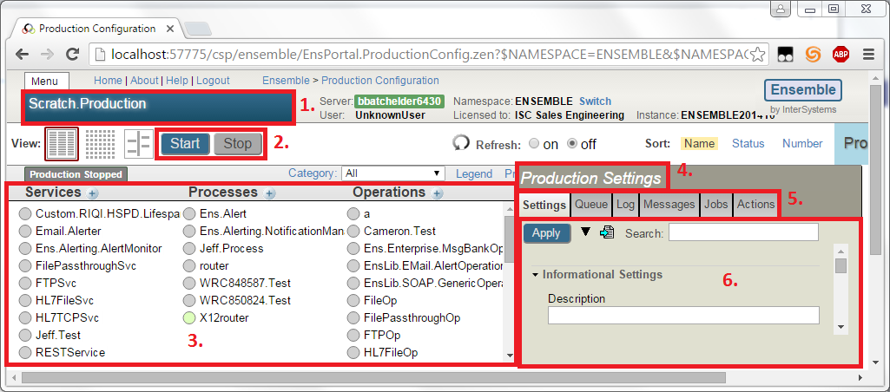
Navigating Ensemble
Production Configuration
Production Name.
Start/Stop the production.
The production components
The name of the currently selected component
Detail categories
Details about the currently selected component
Notes:
1. Production Name. There will be a class with this name which can be edited with studio. Click a circle to see lines indicating internal message routes through the production.
2. Start/Stop the production.
3. The production components (Business Services, Business Processes, and Business Operations). Clicking the circle next to a component here will cause lines to be drawn showing how messages flow through that component.
4. The name of the currently selected component. “Production Settings” when no component is selected.
5. These tabs all pertain to the selected component. When no component is selected, i.e. “Production Settings”, these tabs will show the combined information for all components, except for settings which shows just production-level settings.
6. This pane contains information based on the currently selected component and tab.

Slide 4
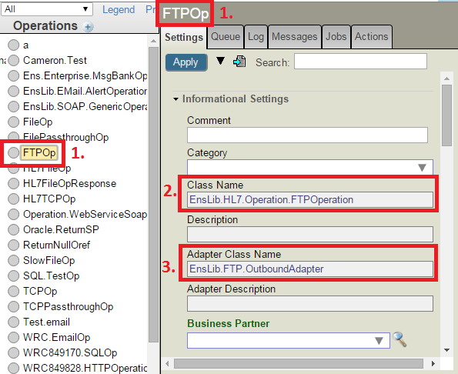
Navigating Ensemble
Component Settings
The name of the currently selected component
The class containing the code for the currently selected component.
The adapter class used by the component class.
Notes:
The name of the currently selected component
The class containing the code for the currently selected component. If this starts with Ens or EnsLib, then it is a standard component provided with Ensemble. If it starts with anything else, it is a custom component coded by the customer.
The adapter class used by the component class. Likewise, if it starts with Ens or EnsLib, it is a standard adapter provided with Ensemble. Customers can code their own adapters but it is very rare to see a custom adapter here.

Slide 5
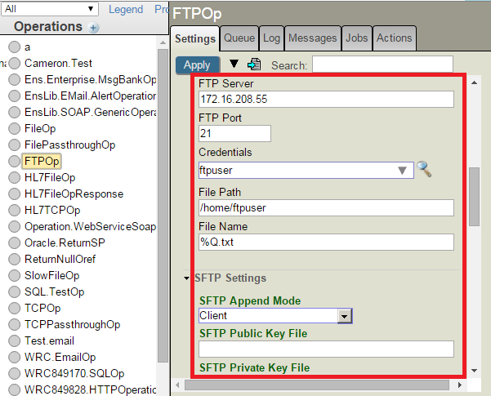
Navigating Ensemble
Component Settings
Settings:
Common settings
Component settings
Adapter settings
(Note: Click any of these labels to get a popup explaining the field.)
Example: FTP Settings
Server & Port
Credentials
Path & Filename
Encryption
Notes:
Settings can be those common to all components, those specific to the current adapter, or those specific to the current component class. The only way to know which class a setting is defined in is by looking at the code.
Here we see settings specific to the FTP outbound adapter, such as the server IP and port, login credentials, and the remote file path.

Slide 6
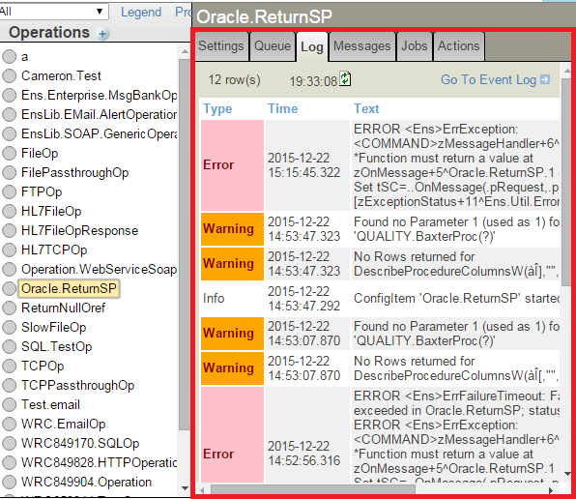
Navigating Ensemble
Component Event Log Tab
The Log tab shows Event Log entries for the selected component. Any errors or warnings are logged here.
This is the first place to check when there is a problem.
The top one here is a <COMMAND> error.
Notes:
When a component has a problem, the first place to look is the event log. All errors and warnings related to this component can be found here.
These errors frequently look like Cache errors you’d get from any other Cache code.
In this screenshot, we can see that the top error in the log is a <COMMAND> error. Looking further, the error happened when method OnMessage in class Oracle.ReturnSP was called, and the problem was that the call expected a return value but the method doesn’t return anything.

Slide 7
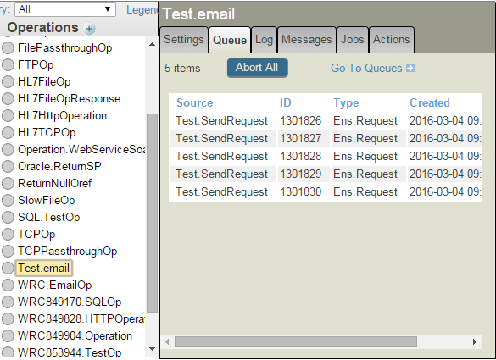
Navigating Ensemble
Queues Tab
Shows messages currently queued for this component.
Queues are stored in ^Ens.Queue
Notes:
Note that messages in a “Queued” status won’t necessarily show up here. It’s possible for them to be deleted from ^Ens.Queue without having their status updated. This would only happen if a user manually deleted the ^Ens.Queue global, or if they ran Ens.Director method CleanProduction, which also cleans out the ^Ens.Queue globals.

Slide 8
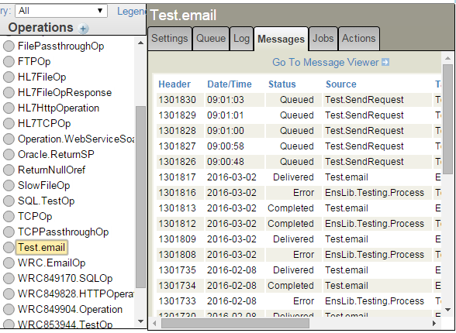
Navigating Ensemble
Messages Tab
Shows all messages sent from or to this component
Contains both previously processed messages and currently queued messages.

Slide 9
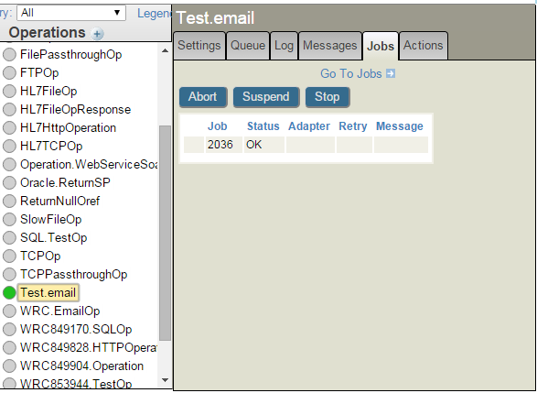
Navigating Ensemble
Jobs Tab
Shows all jobs running the code for this component
Number of jobs determined by “Pool Size” setting
Notes:
The ‘Job’ column actually shows the OS PID, not Cache Job #.

Slide 10
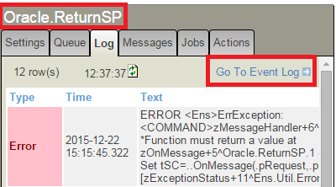
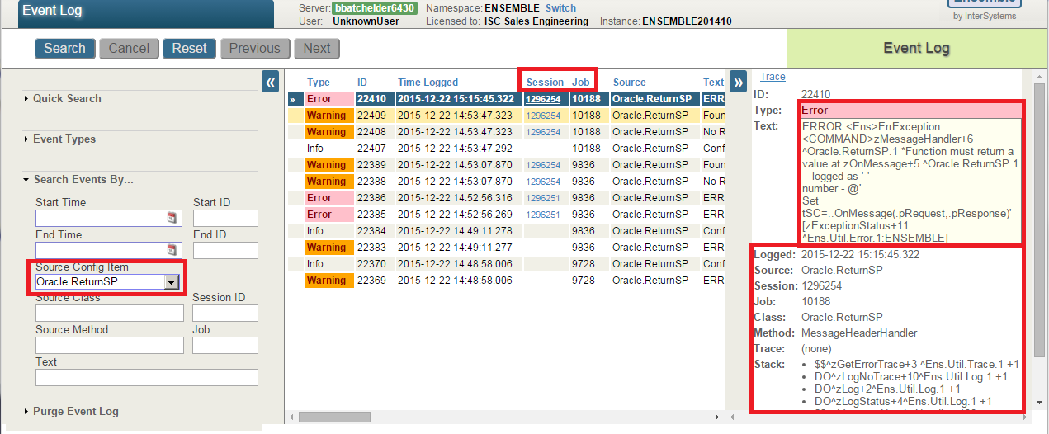
Navigating Ensemble
Event Log
Click “Go To Event Log” to go to the full Event Log Viewer.
Notes:
The “Go To Event Log” link from the log tab will bring you to the Event Log Viewer showing only event logs from the currently selected component.
It is easier to see the full text of the event in the Event Log Viewer, and additional information is available there, such as the PID of the job that logged the event, and the call stack.
Note that the top few lines of the frame stack relate to the logging of the error and the cause of it should be below that.

Slide 11
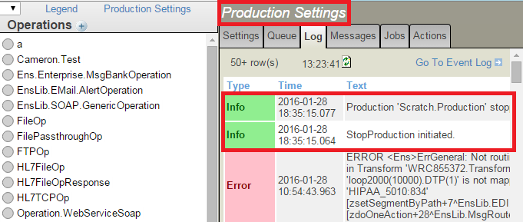
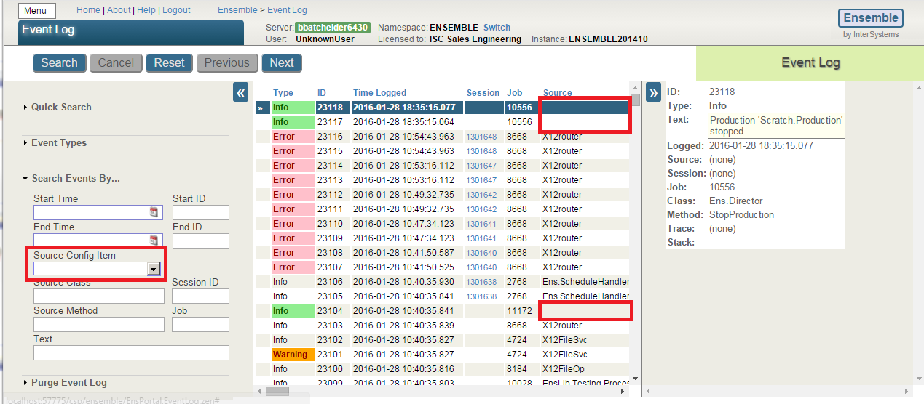
Navigating Ensemble
Production Event Log
When no component is selected, event logs for all components are shown. Those with no source are production-level event logs and this is the only way to see them.
Notes:
Logs related to starting and stopping the production will appear here. The Info items highlighted in green are production-level Event Log entries. They have no source and aren’t associated with any specific component.

Slide 12
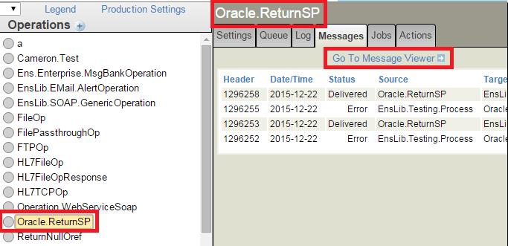
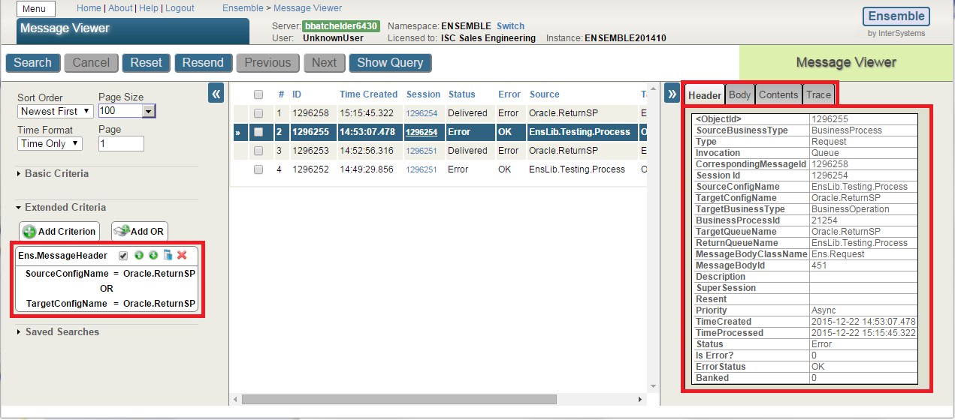
Navigating Ensemble
Message Viewer
Use the ‘Go To Message Viewer’ link to go to the full Message Viewer.
Notes:
The ‘Go To Message Viewer’ link here will bring you to the message viewer, showing messages that were sent to or from the currently selected component.
In the message viewer, the pane on the right shows header and body info as well as the visual trace.

Slide 13
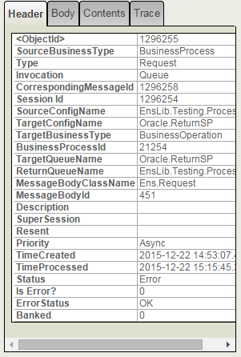
Navigating Ensemble
Message Header
Ens.MessageHeader ID
Session ID
Source and Target components
The message body class and ID
TimeCreated and TimeProcessed
Status of the message
1
2
3
4
5
6
Notes:
Ens.MessageHeader ID. Every time a message is sent from one component to another, a new header is created.
Session ID is the ID of the first message in the session. A session contains all messages in one visual trace.
Source and Target components
The message body class and ID. Can open this with %OpenId and inspect in terminal.
TimeCreated is when the message was first added to the destination queue. TimeProcessed is the time of the last status change.
Status of the message.
Queued: Message is waiting in the queue
Delivered: Target component has removed the message from the queue and started working on it
Complete: Target component is finished with the message
Error: There was an error processing this message – check the event log.

Slide 14
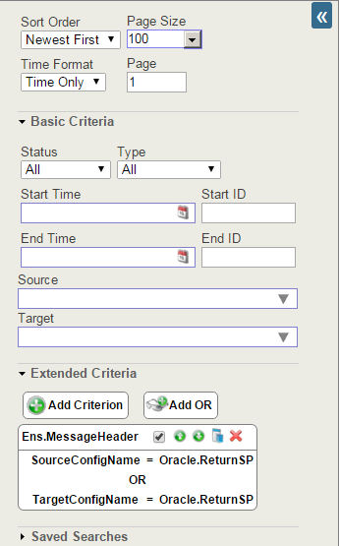

Navigating Ensemble
Message Viewer
3
Basic Search Criteria (Header Data)
Extended Criteria (Header and Body Data)
Message contents
1
2
Notes:
Basic Search Criteria pertains to Message Header data only.
Extended Criteria can include Header and Body fields and allows different kinds of comparisons such as “Contains”, “Starts With”, <, >, etc. Extended criteria can also include Search Table data and Virtual Document Property Paths.
In the right side pane, the “Body” tab shows a table of properties of the body object. The “Contents” tab will show an XML representation of the body if the body class extends %XML.Adaptor. For Virtual Documents, the document contents are shown. The Contents tab is blank for other kinds of message bodies.

Slide 15
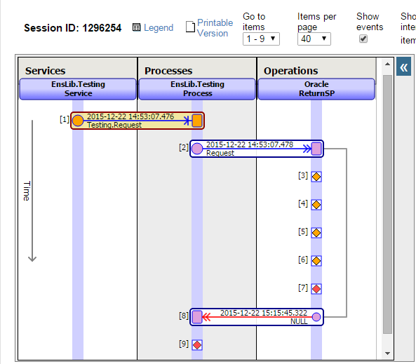
Navigating Ensemble
Visual Trace
1
6
Session ID
Each “column” represents a component in the production.
Each “row” represents a message.
Each diamond represents an Event Log entry.
An arrow pointing from right to left indicates a response, as opposed to a request.
The “Legend” link will explain what all the different colors and shapes mean
2
3
4
5
Notes:
Session ID: All messages in 1 visual trace have the same session ID. It will always be the ID of the first message in the trace.
Each “column” represents a component in the production.
Each “row” represents a message. It extends from one “column” to another, visually showing the message’s source and destination components. In the row, the TimeCreated and MessageBodyClass are shown. Clicking a row populates the pane on the right with the same information from the message viewer.
Each diamond represents an Event Log entry.
An arrow pointing from right to left indicates a response, as opposed to a request. A line will be drawn indicating which request the response is in response to.
The “Legend” link will explain what all the different colors and shapes mean

Slide 16
Questions?

